Slide 1
Vulcan Activity Tracker
CMSC-4920-Senior Project 2
Group2
Team: Margo Bonal, John Gerega, Luke Ruffing

Slide 2
Project Description
The Vulcan Activity Tracker is an athletic app that allows for the tracking of all campus athletics activities.
In one combined platform, the Vulcan Activity Tracker aspires to meet student organization needs, social interaction, and exercise goal planning in a free accessible way!

Slide 3
Weekly Progress
GOALS
Begin Team Page
Implement Password Requirements
Begin Challenges Page
Minor frontend fixes
Complete Friends feature
Display Clubs on Dashboard
Fix Storing Private Activity
Limit viewing activities on dashboard: User and Friend

Slide 4
Challenges
Solutions
All activities stored as public, not registering private
Profile Like and Activity Like crossover
Email password recovery
Viewing Activities list too long
Radio buttons were not ever connected on frontend
New Database table for activity likes
Need more research
Limit Top 10 activities by sorting top newest dates entered

Slide 5
Progress
Vulcan Platform
Database

Slide 6
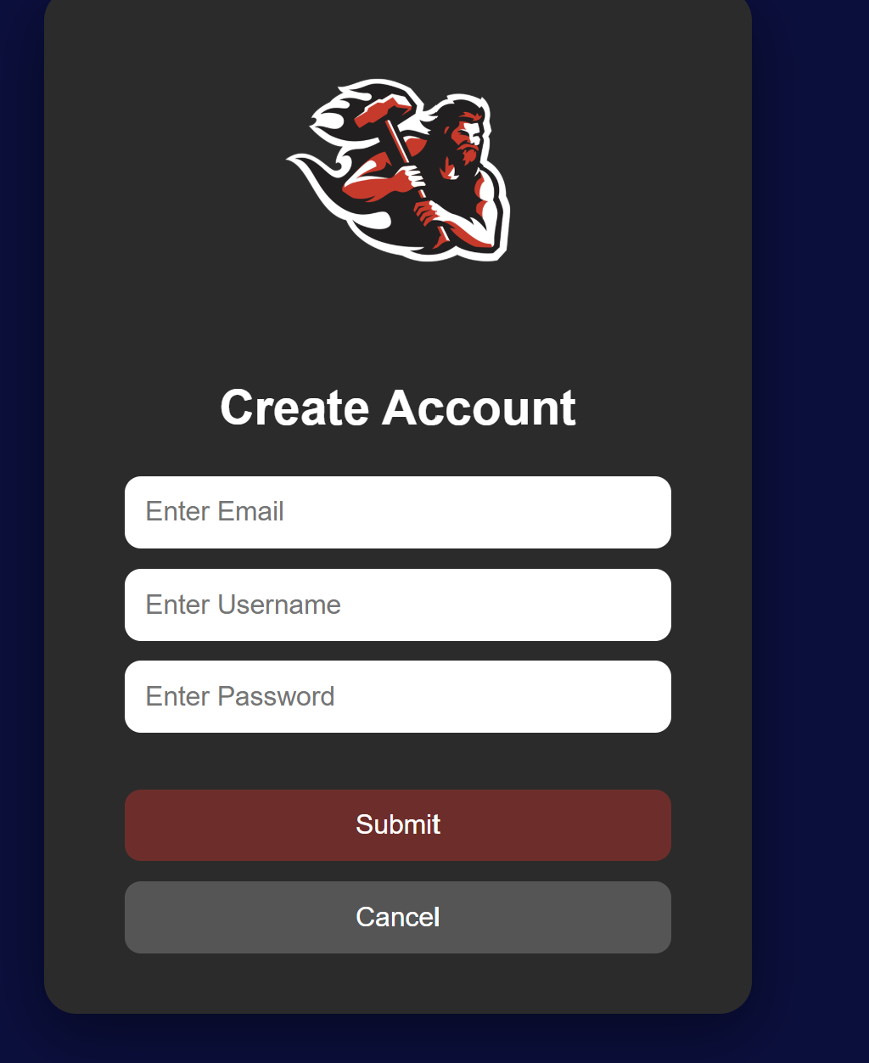
Additon of Email Field
Stores properly in database
Ensures @pennwest.edu email
Needs further development for password recovery

Slide 7
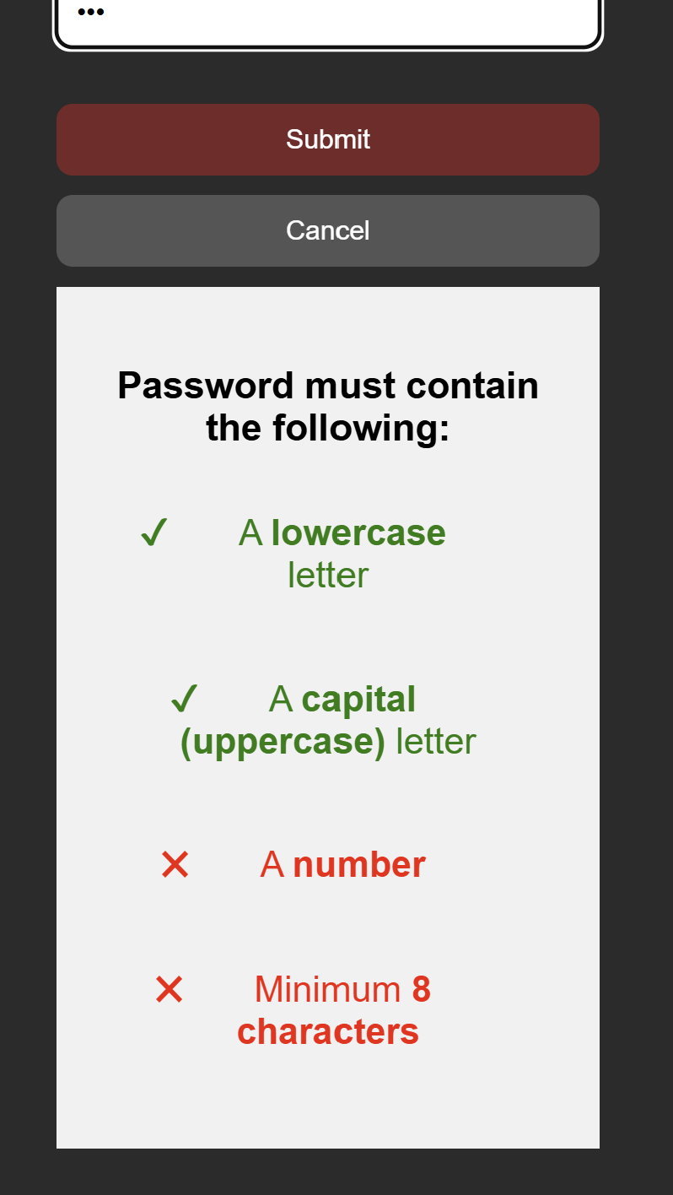
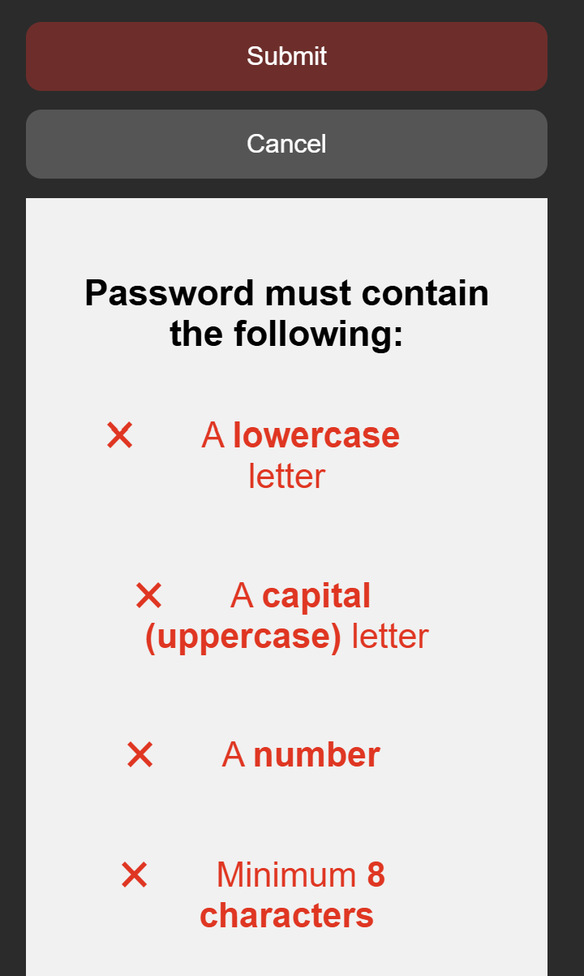
Password Requirements

Slide 8
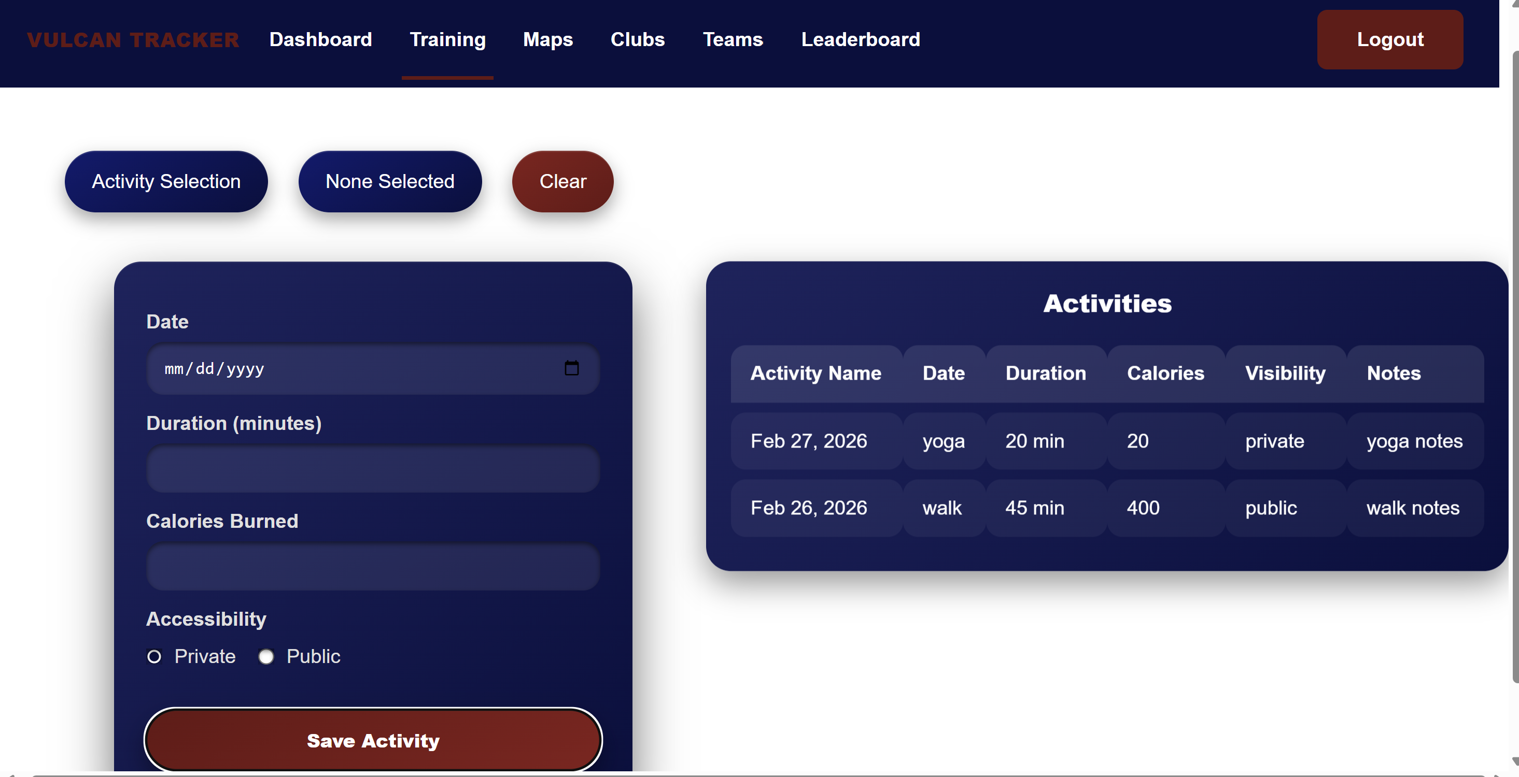
Private Activities Now Stored

Slide 9
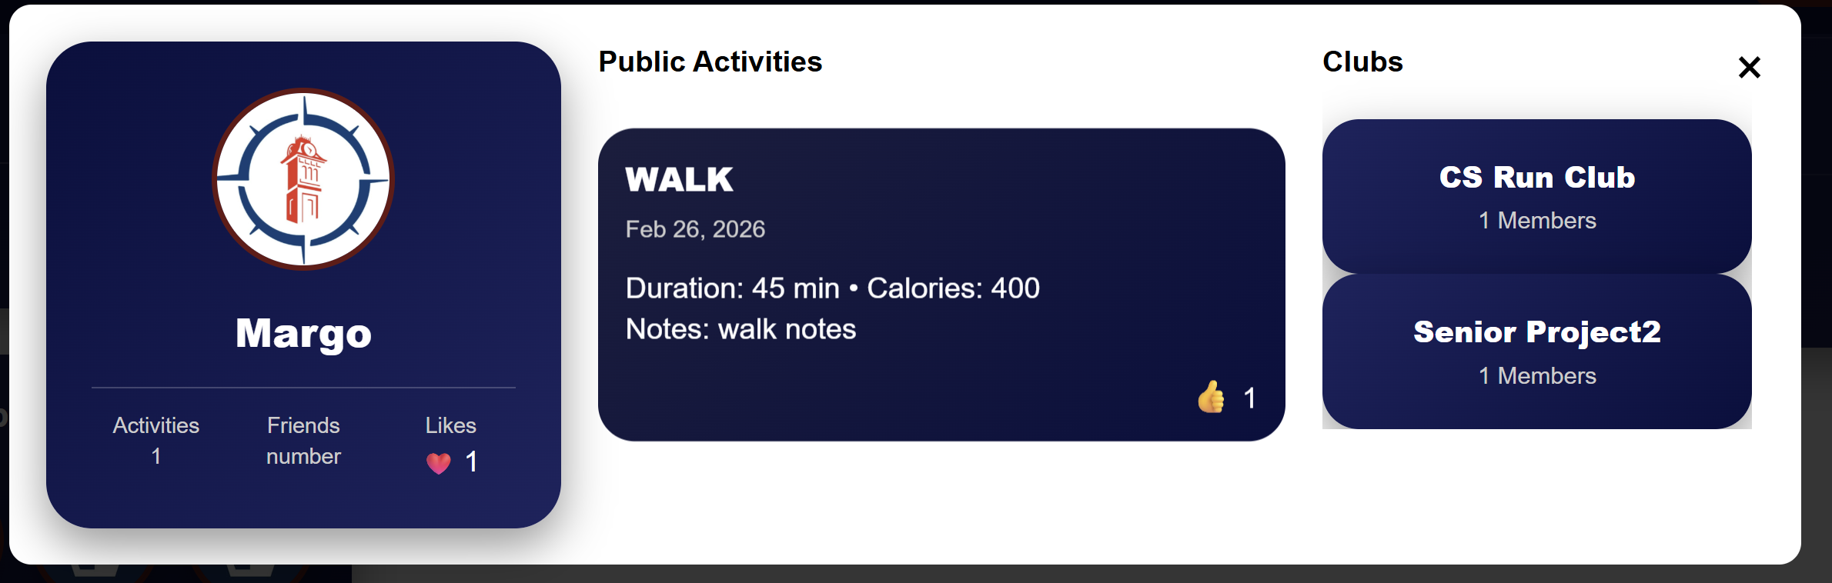
Friend View

Slide 10
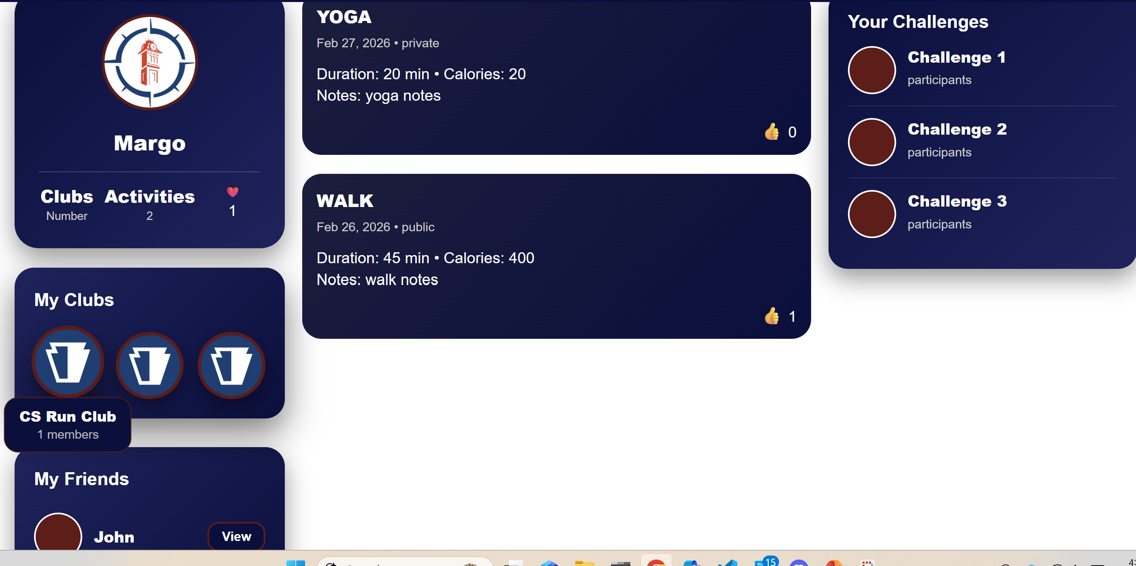
Clubs and Likes

Slide 11
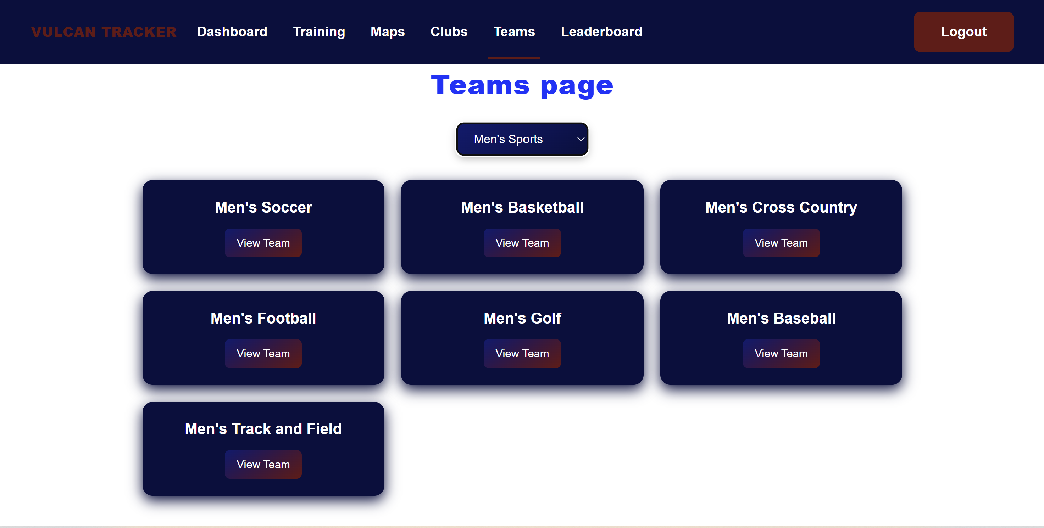
Teams Page
Men’s Sports Teams

Slide 12
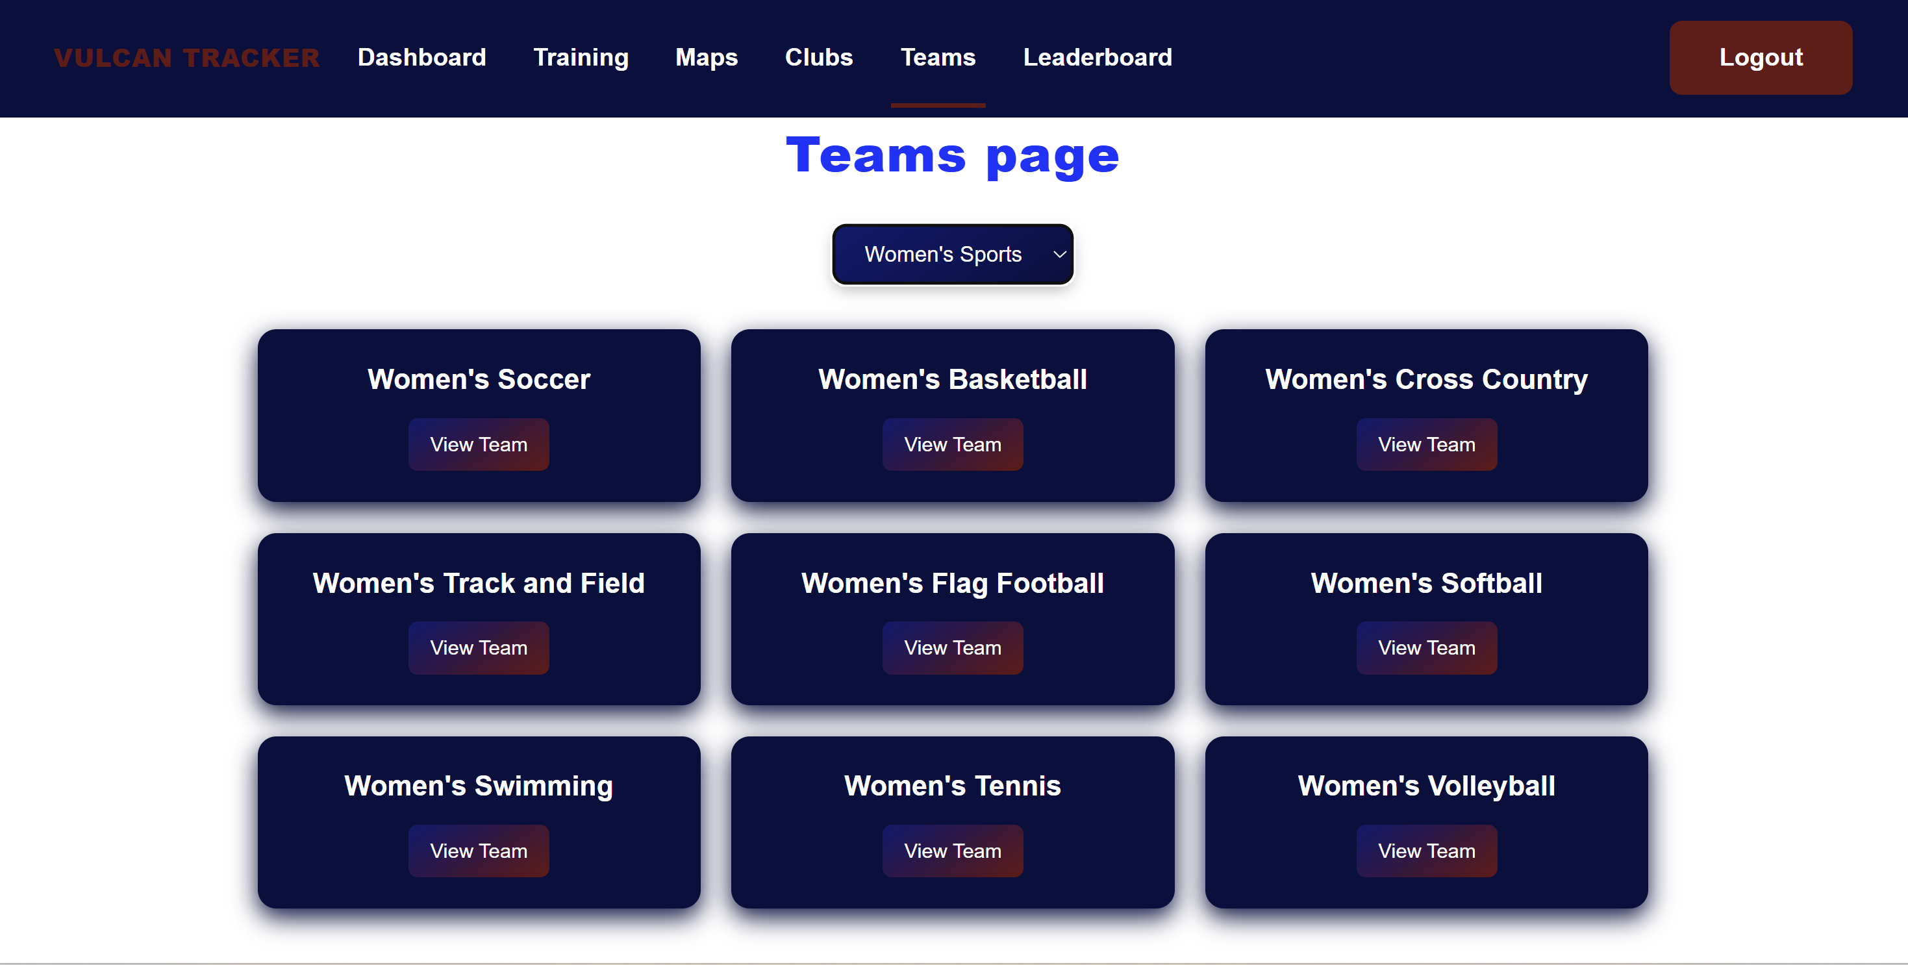
Teams Page
Women’s Sports Teams

Slide 13
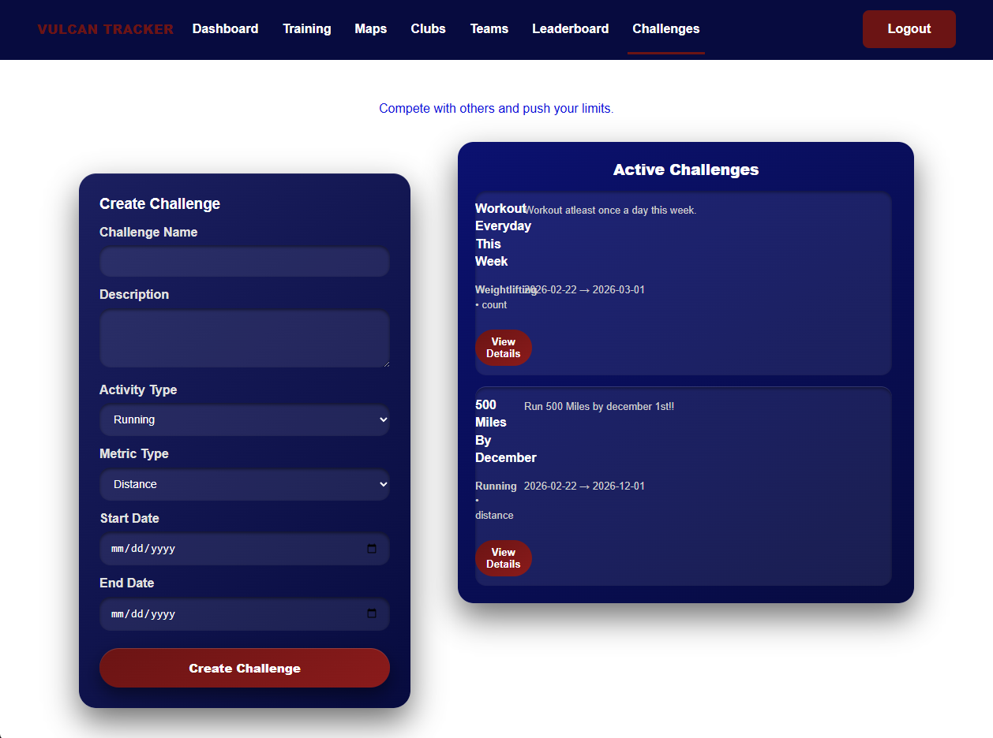
Challenges Page

Slide 14
Week 7 Plan
Implement Login required, can’t reroute to the dashboard manually
Initial beta testing for first impressions
Continue Challenges and Teams Development

Slide 15
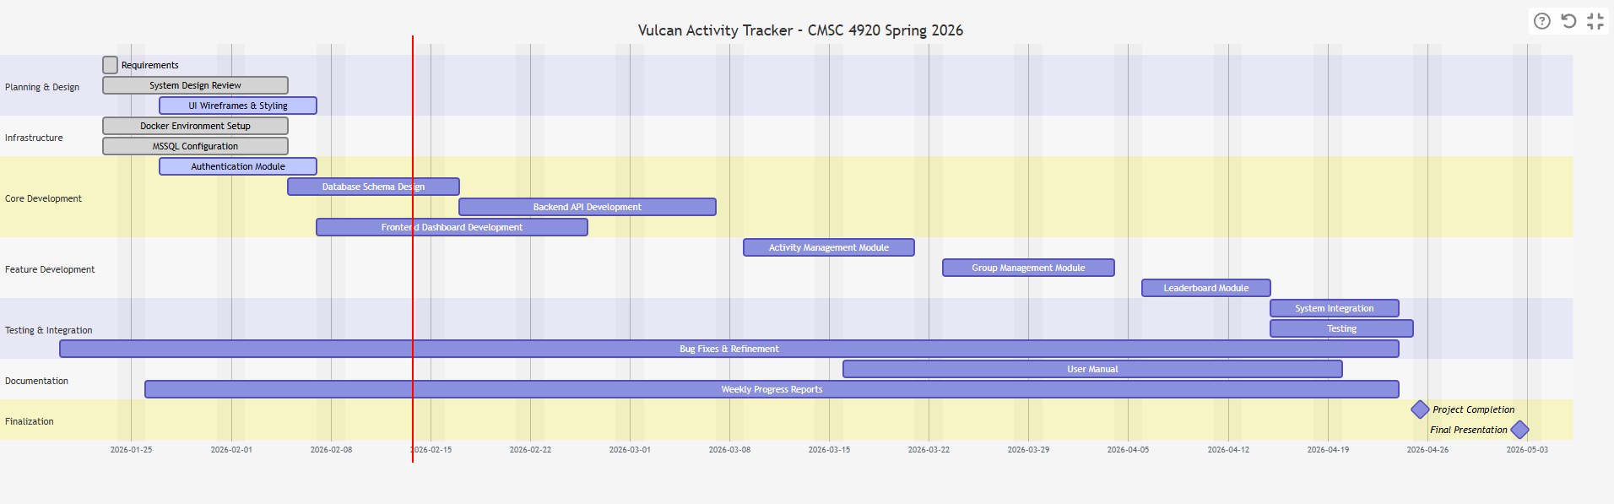
Planning
Gant chart

Slide 16
Website: https://jjdeuce06.github.io/VulcanActivityTracker/

